Slide 1
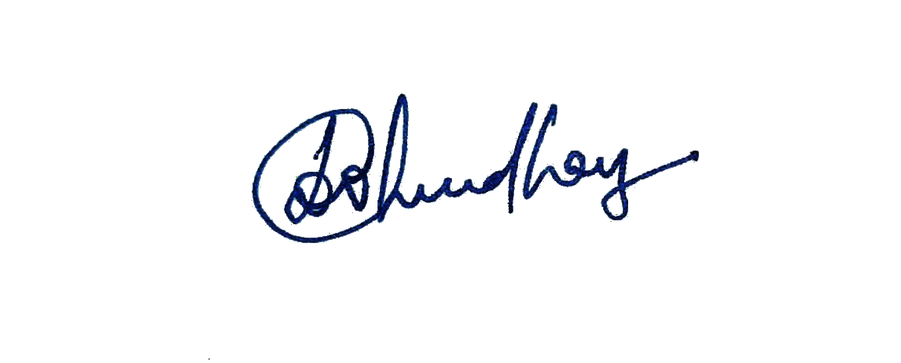
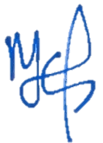
SINHGAD TECHNICAL EDUCATION SOCIETY’S
SINHGAD INSTITUTE OF TECHNOLOGY, LONAVALA
Organized
“Training and Placement Induction Program”
CERTIFICATE of participation
This is to certify that Aishwarya Ravindra Jadhav of Second Year Engineering attended the “Training and Placement Induction Program” organized by, Sinhgad Institute of Technology Lonavala on 17 February 2021.
Dr. D.D. Chaudhary
Vice- Principal
Dr. M. S. Gaikwad
Principal & Campus Director

Slide 2
SINHGAD TECHNICAL EDUCATION SOCIETY’S
SINHGAD INSTITUTE OF TECHNOLOGY, LONAVALA
Organized
“Training and Placement Induction Program”
CERTIFICATE of participation
This is to certify that Awari Suraj Navnath of Second Year Engineering attended the “Training and Placement Induction Program” organized by, Sinhgad Institute of Technology Lonavala on 17 February 2021.
Dr. D.D. Chaudhary
Vice- Principal
Dr. M. S. Gaikwad
Principal & Campus Director

Slide 3
SINHGAD TECHNICAL EDUCATION SOCIETY’S
SINHGAD INSTITUTE OF TECHNOLOGY, LONAVALA
Organized
“Training and Placement Induction Program”
CERTIFICATE of participation
This is to certify that Bone Aniket Vilas of Second Year Engineering attended the “Training and Placement Induction Program” organized by, Sinhgad Institute of Technology Lonavala on 17 February 2021.
Dr. D.D. Chaudhary
Vice- Principal
Dr. M. S. Gaikwad
Principal & Campus Director

Slide 4
SINHGAD TECHNICAL EDUCATION SOCIETY’S
SINHGAD INSTITUTE OF TECHNOLOGY, LONAVALA
Organized
“Training and Placement Induction Program”
CERTIFICATE of participation
This is to certify that Borude Vinayak Bharat of Second Year Engineering attended the “Training and Placement Induction Program” organized by, Sinhgad Institute of Technology Lonavala on 17 February 2021.
Dr. D.D. Chaudhary
Vice- Principal
Dr. M. S. Gaikwad
Principal & Campus Director

Slide 5
SINHGAD TECHNICAL EDUCATION SOCIETY’S
SINHGAD INSTITUTE OF TECHNOLOGY, LONAVALA
Organized
“Training and Placement Induction Program”
CERTIFICATE of participation
This is to certify that Devde Pranjal Vasudev of Second Year Engineering attended the “Training and Placement Induction Program” organized by, Sinhgad Institute of Technology Lonavala on 17 February 2021.
Dr. D.D. Chaudhary
Vice- Principal
Dr. M. S. Gaikwad
Principal & Campus Director

Slide 6
SINHGAD TECHNICAL EDUCATION SOCIETY’S
SINHGAD INSTITUTE OF TECHNOLOGY, LONAVALA
Organized
“Training and Placement Induction Program”
CERTIFICATE of participation
This is to certify that Gaurav Kumar Gupta of Second Year Engineering attended the “Training and Placement Induction Program” organized by, Sinhgad Institute of Technology Lonavala on 17 February 2021.
Dr. D.D. Chaudhary
Vice- Principal
Dr. M. S. Gaikwad
Principal & Campus Director

Slide 7
SINHGAD TECHNICAL EDUCATION SOCIETY’S
SINHGAD INSTITUTE OF TECHNOLOGY, LONAVALA
Organized
“Training and Placement Induction Program”
CERTIFICATE of participation
This is to certify that Govind Sambhaji Bhujbal of Second Year Engineering attended the “Training and Placement Induction Program” organized by, Sinhgad Institute of Technology Lonavala on 17 February 2021.
Dr. D.D. Chaudhary
Vice- Principal
Dr. M. S. Gaikwad
Principal & Campus Director

Slide 8
SINHGAD TECHNICAL EDUCATION SOCIETY’S
SINHGAD INSTITUTE OF TECHNOLOGY, LONAVALA
Organized
“Training and Placement Induction Program”
CERTIFICATE of participation
This is to certify that Gogdand Govind Rajendra of Second Year Engineering attended the “Training and Placement Induction Program” organized by, Sinhgad Institute of Technology Lonavala on 17 February 2021.
Dr. D.D. Chaudhary
Vice- Principal
Dr. M. S. Gaikwad
Principal & Campus Director

Slide 9
SINHGAD TECHNICAL EDUCATION SOCIETY’S
SINHGAD INSTITUTE OF TECHNOLOGY, LONAVALA
Organized
“Training and Placement Induction Program”
CERTIFICATE of participation
This is to certify that Khot Noorin Nasir of Second Year Engineering attended the “Training and Placement Induction Program” organized by, Sinhgad Institute of Technology Lonavala on 17 February 2021.
Dr. D.D. Chaudhary
Vice- Principal
Dr. M. S. Gaikwad
Principal & Campus Director

Slide 10
SINHGAD TECHNICAL EDUCATION SOCIETY’S
SINHGAD INSTITUTE OF TECHNOLOGY, LONAVALA
Organized
“Training and Placement Induction Program”
CERTIFICATE of participation
This is to certify that Rishika Shailesh Thakur of Third Year Engineering attended the “Training and Placement Induction Program” organized by, Sinhgad Institute of Technology Lonavala on 17 February 2021.
Dr. D.D. Chaudhary
Vice- Principal
Dr. M. S. Gaikwad
Principal & Campus Director

Slide 11
SINHGAD TECHNICAL EDUCATION SOCIETY’S
SINHGAD INSTITUTE OF TECHNOLOGY, LONAVALA
Organized
“Training and Placement Induction Program”
CERTIFICATE of participation
This is to certify that Amal Pushp of Third Year Engineering attended the “Training and Placement Induction Program” organized by, Sinhgad Institute of Technology Lonavala on 17 February 2021.
Dr. D.D. Chaudhary
Vice- Principal
Dr. M. S. Gaikwad
Principal & Campus Director

Slide 12
SINHGAD TECHNICAL EDUCATION SOCIETY’S
SINHGAD INSTITUTE OF TECHNOLOGY, LONAVALA
Organized
“Training and Placement Induction Program”
CERTIFICATE of participation
This is to certify that Bargal Mahesh Santosh of Third Year Engineering attended the “Training and Placement Induction Program” organized by, Sinhgad Institute of Technology Lonavala on 17 February 2021.
Dr. D.D. Chaudhary
Vice- Principal
Dr. M. S. Gaikwad
Principal & Campus Director

Slide 13
SINHGAD TECHNICAL EDUCATION SOCIETY’S
SINHGAD INSTITUTE OF TECHNOLOGY, LONAVALA
Organized
“Training and Placement Induction Program”
CERTIFICATE of participation
This is to certify that Gawande Praful Sandiprao of Third Year Engineering attended the “Training and Placement Induction Program” organized by, Sinhgad Institute of Technology Lonavala on 17 February 2021.
Dr. D.D. Chaudhary
Vice- Principal
Dr. M. S. Gaikwad
Principal & Campus Director

Slide 14
SINHGAD TECHNICAL EDUCATION SOCIETY’S
SINHGAD INSTITUTE OF TECHNOLOGY, LONAVALA
Organized
“Training and Placement Induction Program”
CERTIFICATE of participation
This is to certify that Jayesh Mali of Third Year Engineering attended the “Training and Placement Induction Program” organized by, Sinhgad Institute of Technology Lonavala on 17 February 2021.
Dr. D.D. Chaudhary
Vice- Principal
Dr. M. S. Gaikwad
Principal & Campus Director

Slide 15
SINHGAD TECHNICAL EDUCATION SOCIETY’S
SINHGAD INSTITUTE OF TECHNOLOGY, LONAVALA
Organized
“Training and Placement Induction Program”
CERTIFICATE of participation
This is to certify that Kumari Radhika of Third Year Engineering attended the “Training and Placement Induction Program” organized by, Sinhgad Institute of Technology Lonavala on 17 February 2021.
Dr. D.D. Chaudhary
Vice- Principal
Dr. M. S. Gaikwad
Principal & Campus Director

Slide 16
SINHGAD TECHNICAL EDUCATION SOCIETY’S
SINHGAD INSTITUTE OF TECHNOLOGY, LONAVALA
Organized
“Training and Placement Induction Program”
CERTIFICATE of participation
This is to certify that Nikhil Jadhav of Third Year Engineering attended the “Training and Placement Induction Program” organized by, Sinhgad Institute of Technology Lonavala on 17 February 2021.
Dr. D.D. Chaudhary
Vice- Principal
Dr. M. S. Gaikwad
Principal & Campus Director

Slide 17
SINHGAD TECHNICAL EDUCATION SOCIETY’S
SINHGAD INSTITUTE OF TECHNOLOGY, LONAVALA
Organized
“Training and Placement Induction Program”
CERTIFICATE of participation
This is to certify that Patil Samir Rajesh of Third Year Engineering attended the “Training and Placement Induction Program” organized by, Sinhgad Institute of Technology Lonavala on 17 February 2021.
Dr. D.D. Chaudhary
Vice- Principal
Dr. M. S. Gaikwad
Principal & Campus Director

Slide 18
SINHGAD TECHNICAL EDUCATION SOCIETY’S
SINHGAD INSTITUTE OF TECHNOLOGY, LONAVALA
Organized
“Training and Placement Induction Program”
CERTIFICATE of participation
This is to certify that Birajdar Vaibhavkumar Anantrao Rajesh of Third Year Engineering attended the “Training and Placement Induction Program” organized by, Sinhgad Institute of Technology Lonavala on 17 February 2021.
Dr. D.D. Chaudhary
Vice- Principal
Dr. M. S. Gaikwad
Principal & Campus Director

